Slide 1

Topic 4: The Process of Academic Writing

Slide 2
Agenda
Warm-up
The process of academic writing
Four stages of a writing process
Feedback
Guidelines for providing and using peer feedback
Peer feedback practice

Slide 3
Reflection on our prior experience
What kind of English writing tasks have you done in the past? (How about Chinese writing tasks?)
Do you write in multiple drafts or a single draft?
Have you ever received feedback on your English writing? If so, what kind of feedback have you received?
What did you do with this feedback?
Have you ever revised your English writing?
What difficulties did you have in revising your writing?

Slide 4
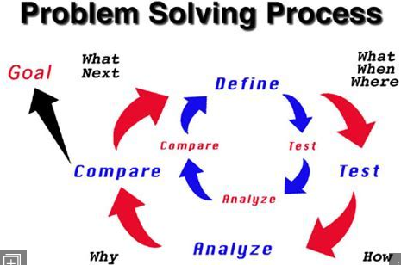

Writing as a process
Writing is a cognitive, problem-solving activity
Writing is a recursive process
Writers discover and reformulate their ideas as they attempt to approximate meaning

Slide 5
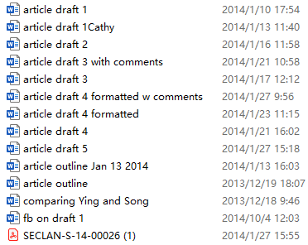
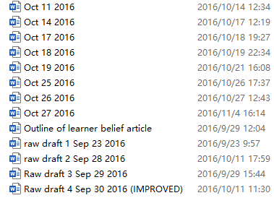
Writing multiple drafts is unavoidable in academic writing

Slide 6
Four stages of a writing process
Writing
Creating
Revising
Drafting
Outlining

Slide 7
Creating/Pre-Writing
Goal-setting
What writing task? (genre & assessment criteria)
Whom to write for? (audience)
Idea development
Thesis (main point)
Sub-points
Concrete support
Logic!!!

Slide 8
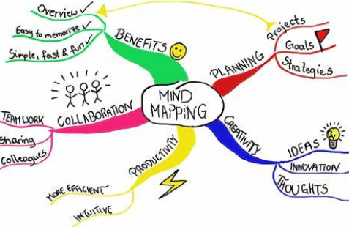
Creating/Pre-Writing
Strategies for the goal-setting:
Carefully read the prompt (题目）
Thoroughly understand assessment criteria
If possible, closely read exemplars
Strategies for the idea development
Journaling
Free writing
Mind-map
Clustering
Do some research really helps!

Slide 9
Creating/Pre-Writing
Think about Your Audience:
Who is the audience for your writing?
Do you think your audience is interested in the topic? Why or why not?
Why should your audience be interested in this topic?
What does your audience already know about this topic?
What does your audience need to know about this topic?
What experiences has your audience had that would influence them on this topic?
What do you hope the audience will gain from your text?

Slide 10
Creating/Pre-Writing
Brainstorm.
Gather as many good and bad ideas, suggestions, examples, sentences, false starts, etc. as you can.
Perhaps some friends can join in.
Jot down everything that comes to mind, including material you are sure you will throw out.
Be ready to keep adding to the list at odd moments as ideas continue to come to mind.

Slide 11
Outlining
Write down the outline!
Main point, sub-points, and major concrete supports
Use bullet points or letters and numbers

Slide 12
Outlining
For example, an outline for a five-paragraph essay on why I love my dog might have the following headings:
I. INTRODUCTION
II. BODY PARAGRAPH 1: My Dog is a Good Companion
III. BODY PARAGRAPH 2: My Dog is Well-Behaved
IV. BODY PARAGRAPH 3: My Dog is Cute
V. CONCLUSION

Slide 13
Outlining
II. Body Paragraph 1: My Dog is a Good Companion
A. My dog is fun
1. My dog likes to play
2. My dog likes to go on walks
B. My dog is friendly
1. My dog likes to cuddle
2. My dog likes people

Slide 14
Outlining
II. Body Paragraph 1: My Dog is a Good Companion
Each of those ideas is then further explained through examples: My dog is fun because he like to play and go on walks. I know my dog is friendly since he enjoys cuddling and like people. Even more detail could be added by including specific games my dog likes to play, behaviors that tell me he like to go on walks, and so. The more detail you add, the easier it will be to write you paper later on!

Slide 15
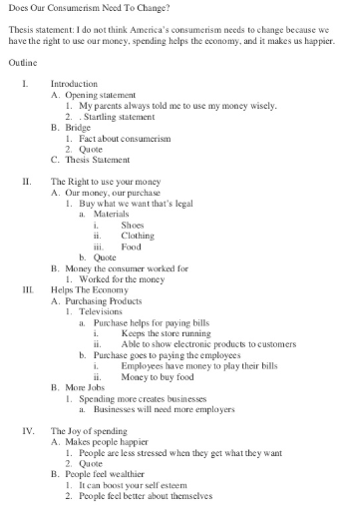
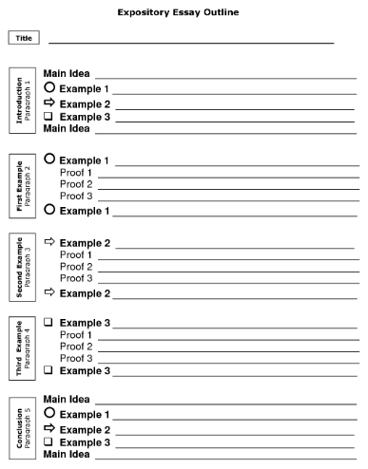

Slide 16
Drafting
“The first draft of anything is shit.” —Ernest Hemingway
Drafting and redrafting is part of good writing practice
Start drafting without procrastination
Don’t worry about linguistic accuracy in the first/second draft
Writer’s block is common
Don’t blame yourself
When it happens, put your draft aside for one or two days and resume writing
Read others’ work to get inspirations
Seek feedback from others (peers, friends, parents, e-pals, etc.)

Slide 17
Revising and polishing
Content-based revision
Is your writing logical and convincing?
Does your draft written look acceptable to academics?
Academic conventions are essential
Linguistic accuracy
Spelling, punctuation, formatting, referencing styles
Tools and resources
Spelling & grammar check software
Corpus (e.g., COCA)
Monolingual (academic) dictionaries: Merriam-Webster, Longman, etc.

Slide 18
Feedback
Have you ever received feedback on your English writing?
From whom?
What kind of feedback?
What did you do with that feedback?
How much/little have you learned from that feedback?
What feedback, if possible, would you prefer to receive?

Slide 19
Feedback
Teacher feedback, peer feedback, self feedback, and machine feedback
Each has its pros and cons
But for graduate students, you need to develop learner autonomy and critical thinking skills.
Seeking feedback from different sources would really help

Slide 20
Peer feedback
Discussion
Have you ever heard of/ provided/ received peer feedback?
What was your experience like?
What do you think of this kind of feedback?
What are your concerns about peer feedback (if any)?

Slide 21

Peer feedback

Slide 22
Peer feedback
Develop your awareness of the audience
Help you spot errors and problems in your own writing
Develop critical thinking skills and communication skills
Prepare you for engaging with peer review process in academic publication
Teachers are not the only source of knowledge; your peers have valuable knowledge as well!

Slide 23
General guidelines for offering peer feedback
Be confident. You are able to help others improve their writing.
Be attentive. Read others’ work very carefully before commenting.
Be honest. Do not provide insincere praise. Point out both strengths and weaknesses.
Be constructive. Do not just criticize your peer. Give suggestions to help him/her.
Be polite. Do not give too harsh comments.

Slide 24
General guidelines for using peer feedback
Trust each other. Your peers are capable and qualified to contribute to your work.
Be frank, nice, but also critical. Even the best feedback giver sometimes offers useless feedback.
Think of ways to solve the problems that your peers find out for you.
Interact with your peers. If you do not understand the feedback, or your writing is misunderstood, talk to the feedback giver and find out what has gone wrong.

Slide 25
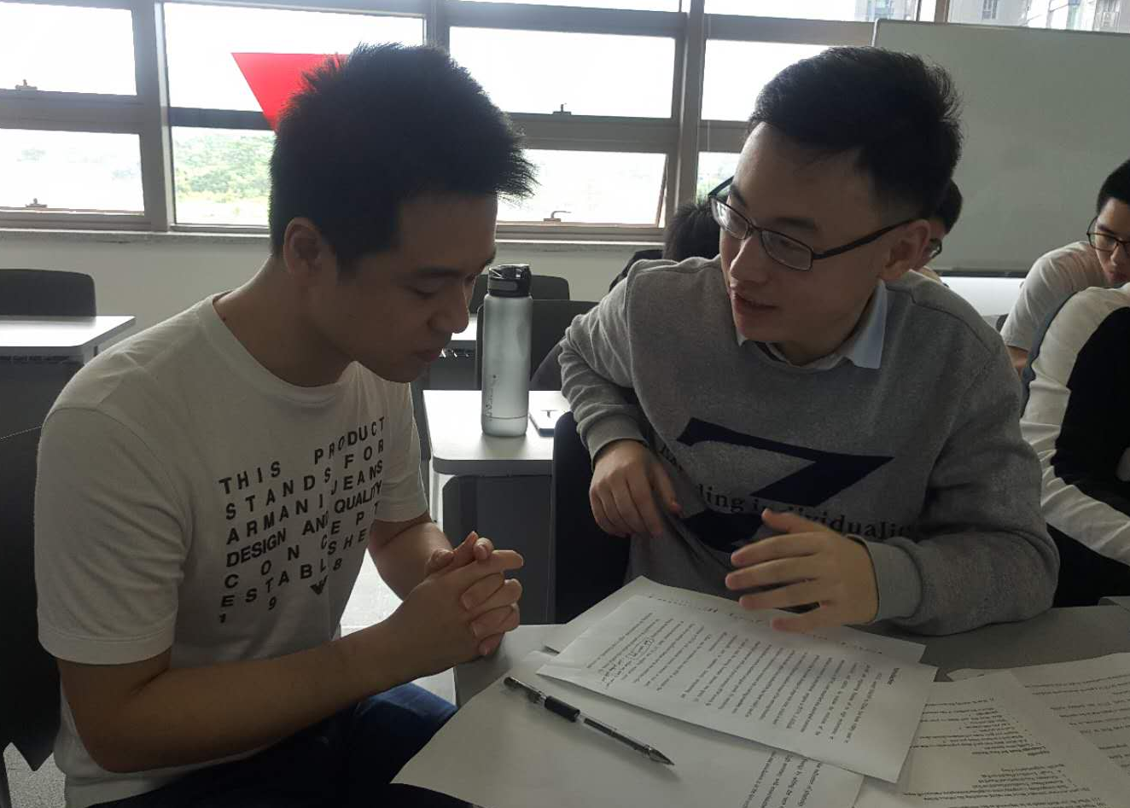
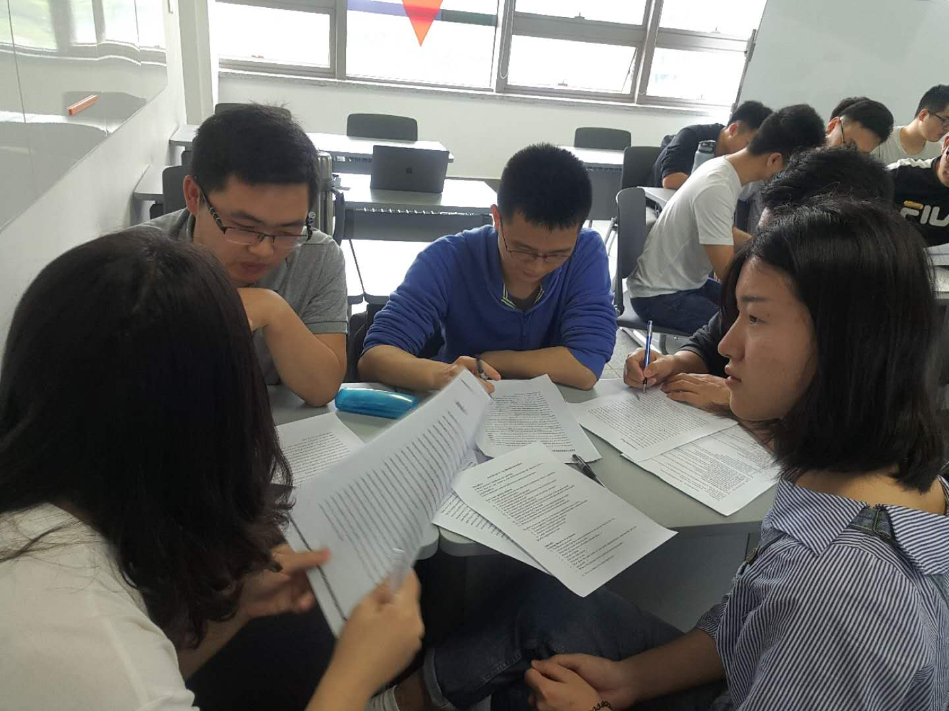

Slide 26
Exercise
In pairs, choose one of the topics below:
It is worth the expense and risk to make a manned flight to Mars.
The future status of English as the global language is assured.
Decide which side you agree with.
Write a thesis statement.
Make a list of ideas/supporting reasons for both sides of the argument
Decide which suits the topic better, the block pattern or the point-by-point pattern.

Slide 27
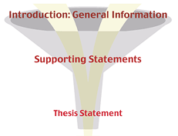
Step 2: Introduction
Funnel introduction
Thesis: (formal) a statement or an opinion that is discussed in a logical way and presented with evidence in order to prove that it is true.
Notes:
Source: https://web2.uvcs.uvic.ca/encomium/writingdemo/wa/unit1/u1_l1b_a.htm

Slide 28
Funnel Introduction
General information
is a HOOK to catch the reader’s attention
should be a broad, general statement that does not mention your topic
Supporting statements
narrows down the broad, general statement
leads to and supports your thesis
Thesis statement
is usually the last sentence
tells exactly what the whole paper is about

Slide 29
Funnel Introduction
General information
is a HOOK to catch the reader’s attention
should be a broad, general statement that does not mention your topic
Supporting statements
narrows down the broad, general statement
leads to and supports your thesis
Thesis statement
is usually the last sentence
tells exactly what the whole paper is about

Slide 30
An example of the funnel introduction
Mankind has always been a complaining species. Every generation claims to have hardships not encountered by other groups. In the twentieth century, however, one group's complaints are completely justified. Evidence clearly shows that modern teenagers do, in fact, have a very difficult life.

Slide 31
Thesis statement pitfalls
The thesis is too general.
E.g., Higher education is critical to a country’s development.
It makes a simple announcement.
E.g., I am going to discuss how to write a journal article.
It states an obvious fact.
E.g., Doing exercise regularly is good for our health.
Can you find the thesis statement in the sample paper?
Do you think it is a good one?

Slide 32
Sample Writing Introduction
Education means considerably more than just teaching a student to read, write, and manipulate numbers. Computers, the Internet, and advanced electronic devices are becoming essential in everyday life and have changed the way information is gathered. How this new technology is utilized in the curriculum and managed by teachers will have an important role to play in widening the resource and knowledge base for all students. Technology affects the way teachers teach and students learn. To make the best use of information technology (IT), schools need a workable plan to fully integrate it into all aspects of the curriculum so students are taught how, why, and when to use technology to further enhance their learning.

Slide 33
Sample Writing Introduction
PROMPT: Some people believe that a college or university education should be available to all students. Others believe that higher education should be available only to good students. Discuss these views. Which view do you agree with? Use specific reasons and examples to support your opinion.
Some people believe that university students should be required to attend classes. Others believe that going to classes should be optional for students. The former is my point of view, there are several reasons.

Slide 34
Sample Writing Introduction
Higher education should be only available to good students
With the development of society, country and family pay more attention to children’s education. It is an important indicator to evaluate children’s future by judge whether they children are admitted to a university. Some people believe that a college or university education should be available to all students. However, I strongly advocate that higher education should eb only available to good students. The reasons for my preference would be elucidated as follows.

Slide 35
Sample Writing Introduction
Higher Education Should Be Only Available to Good Students
With the development of society, country and families pay more and more attention to children’s education. It is an important indicator to evaluate children’s future by judging whether students are admitted to a university. Some people believe that a college or university education should be available to all students. However, I strongly advocate that higher education should be only allowed to good students.

Slide 36
Hooks and attention grabbers
An “attention getter”, also known as an “attention grabber” or “hook”, refers to the first 1-4 sentences of an essay. On average, people only read the first 2 sentences before deciding if your essay will be an interesting read or a chore.
Examples of attention grabbers
A definition | A quotation | A striking fact | A comparison
A question | A story | A joke | Striking numbers/statistics

Slide 37
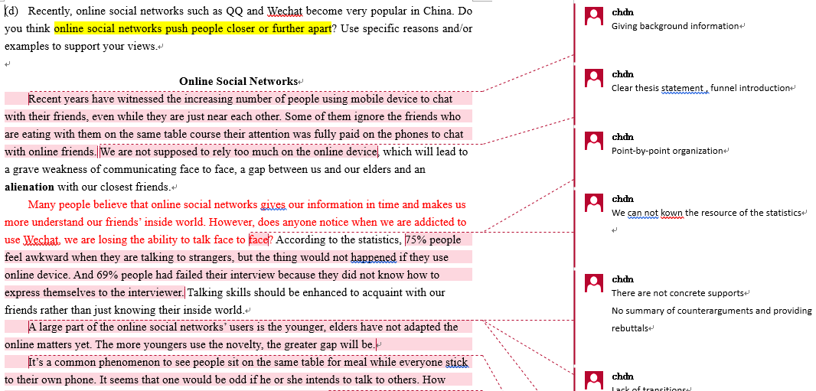

Slide 38
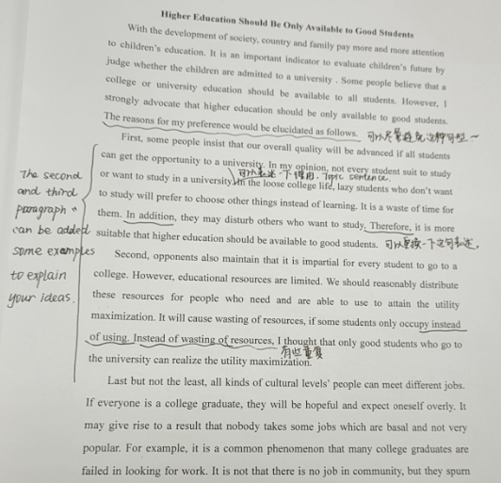
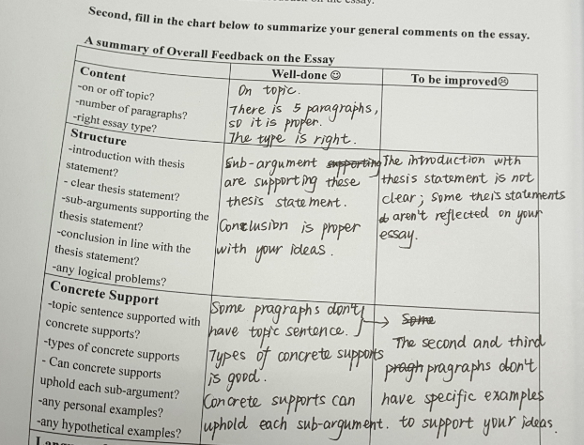

Slide 39
Four steps when providing peer feedback
Clarifying the writer’s intention
Try to get further explanation of what writers have said or what is not clear to them in the essays (e.g., unknown terms, idea)
What do you mean by “the poverty of vocabulary”?
Identifying the problems
Announce a problematic word, phrase, sentence or cohesive gap
I think this example cannot effectively support your argument.
Explaining the nature of the problem
Explain why you think an idea, the paragraph, or a sentence/word, is problematic.
You should put some phrases before you make this quotation because the last paragraph is unrelated to the fourth paragraph.
Making specific suggestions
Suggest ways to improve.
If you’re trying to say many people have more than one cell phone, maybe you can say “the majority of have a cell phone with them, some even with more than one”.

Slide 40
Teacher demonstration
If time permits, the teacher can demonstrate how to provide peer feedback in aforementioned four steps.

Slide 41
Peer feedback practice
Either in pairs or in small groups (depends on the number of students and the classroom layout)
Either hand-written or in electronic form (depends on students’ devices)
Encourage students to follow the four steps and highlight the necessity of seeking clarification, an analyzing the problem, and providing suggestions (not just criticizing)

